Slide 1

Home Network & Heat Mapping
Naiya Whitley
Mis 4123.601 Telecomm Networked Systems

Slide 2
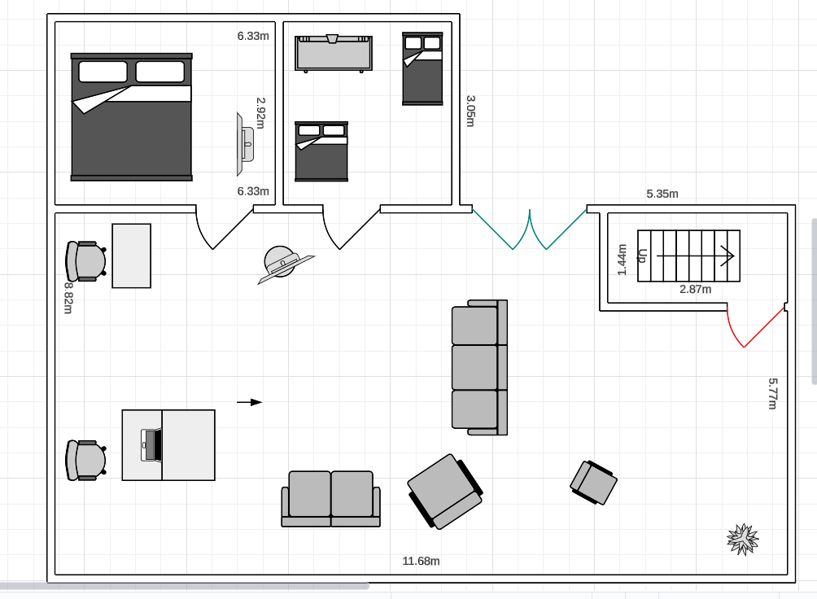


Home Diagram
OSI Layer 3
OSI Layer 7
IP:50.25.141.XXX
OSI Layer 7
OSI Layer 7
OSI Layer 7
IP:50.25.141.XXX
OSI Layer 7

Slide 3
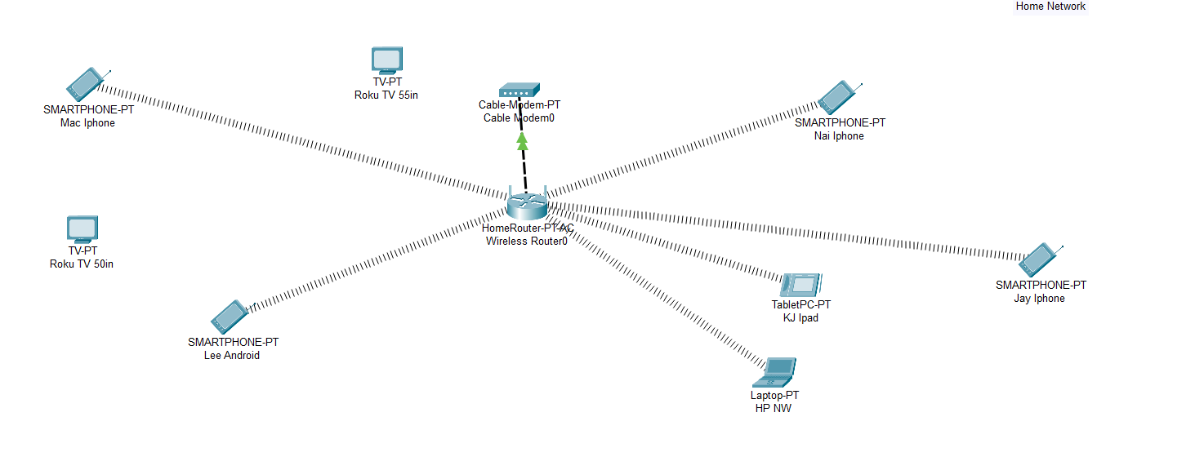
Home Connectivity Diagram

Slide 4
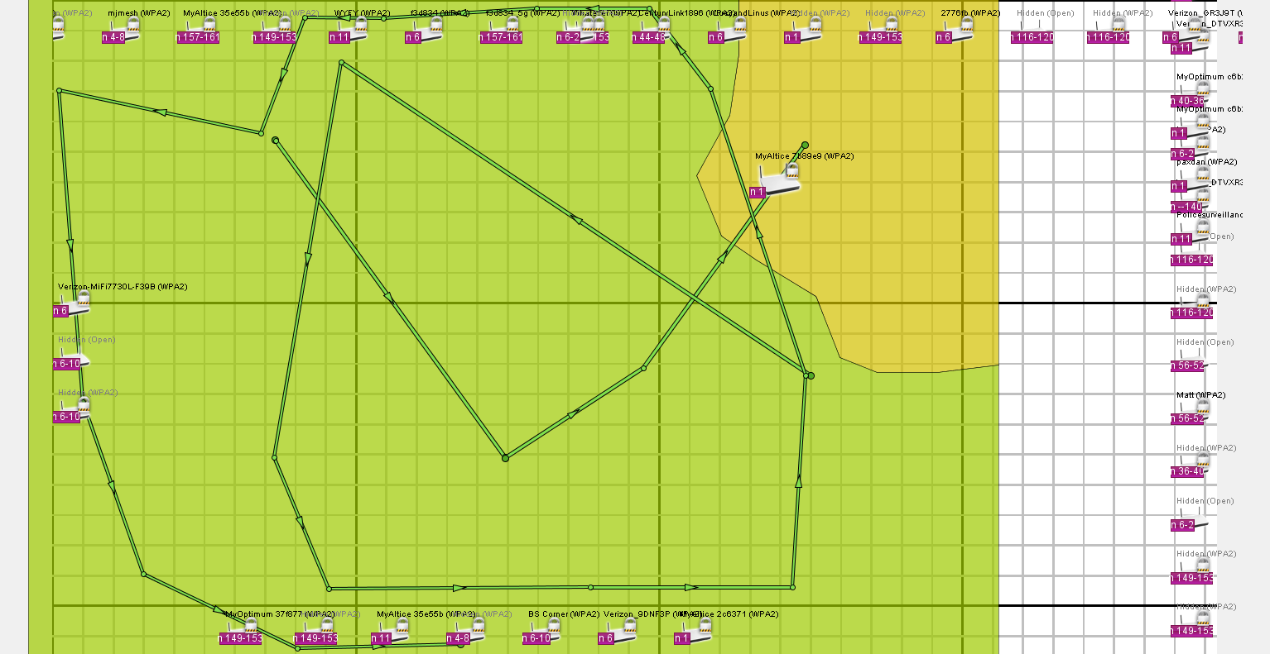
Heat Map

Slide 5
Final Remarks

